Slide 1

Dayton-Hudson Corporation
Jasmine Roberts
Bowie State University
CTEC 410-101SPRG2024
Henry Okonofua
March 13, 2024

Slide 2

History & Background
Target was founded in 1961 by George Dayton
was then named Dayton’s Explored Discount retail
The Dayton Company” to strengthen relationships with guests and company leadership
(1962)The Dayton Company decided to name the retail store “Target”, with a bullseye logo.
(1966) Target opened two stores in Denver Colorado as its further steps into making the supply chain national
(1967) The Dayton Corporation transformed into a national retailer.
(1971) Target was the first barrier free store in Denver with its accessibility and to hire people with disabilities.
(1988) Introduction of UPC Scanning was invented and was the first in-store technology they had.
(1989)Target expanded from just one store in Minnesota to 400 stores across the United States.

Slide 3
Networking Concepts used in Target
Point of Sale Computers (POS):
maintains the records of transactions and items sold within a store
sales item is scanned within the scanner
the price of the item shows up on the POS computer to symbolize how much is owed
POS computers are cloud based machines
optimize the checkout process which would help the speed of the line
Barcode Reader/NPC:
hand-held device that is used to capture and read information that is inside of a barcode
scanner converts the light energy into electrical energy, which is then converted into data by the decoder and forwarded to a computer
translates the barcode into numbers and letters

Slide 4
Networking Concepts used in Target
Handheld Barcode Reader:
it scans physical items into digital format, which means it can be stored and transferred within the digital network
it consists of an actual reading unit and a decoding unit
the decoding unit would pertain to the reading unit which would be used mostly in retail
Fixed Position Barcode Reader:
is built to always stay in one spot
they are good for situations that deal with fast moving items.
they are permanently installed in a fixed location, such as for Target in checkout counters.
they are designed for high-volume scanning tasks

Slide 5
Networking Concepts used in Target
Wireless WAN:
WAN provides a wireless network anywhere in the network providers coverage zones for access
it provides connectivity for a range of situations that are not suitable for LAN
Artificial Intelligence (AI):
allows a computer/machine to simulate human intelligence and problem-solving capabilities
this would be referred to as machine learning such as different AI algorithms and decision-making processes as if it had a human brain
target uses AI for assortment planning and stock count

Slide 6
Networking Concepts used in Target
Non-Fungible Tokens:
unique identification codes created from metadata within encryption functions
tokens are stored on a blockchain, NFTs can be traded and exchanged for money, and cryptocurrencies
NFT are assets used to create and authenticate ownership of digital assets
Retail Video Analytics:
extracts information and insights from video footage
it can enhance security monitoring.
reduces manual effort and enhances data-driven decision making for retailers of its operation

Slide 7
Networking Concepts used in Target
Cross Band-Network:
method of telecommunication in which a radio station receives signals on one frequency
simultaneously transmits on another for the purpose of full duplex communication or signal relay
Routers:
customers expect Wi-Fi internet access in stores, improve responses to customers and
enable easier access to customer information
these are real benefits at a time when customers demand fast answers to questions, as well as personalized service

Slide 8
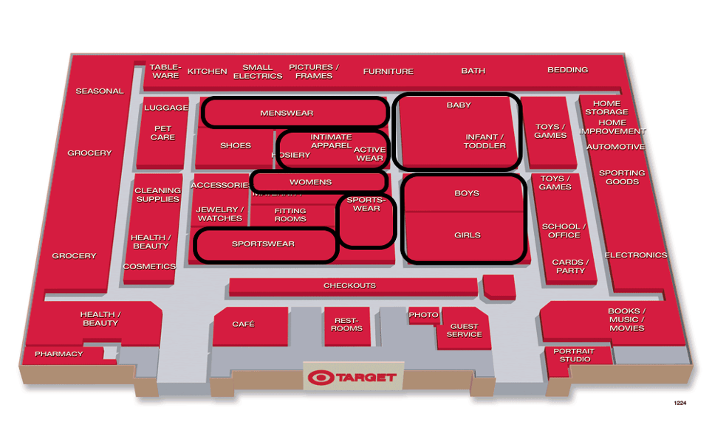
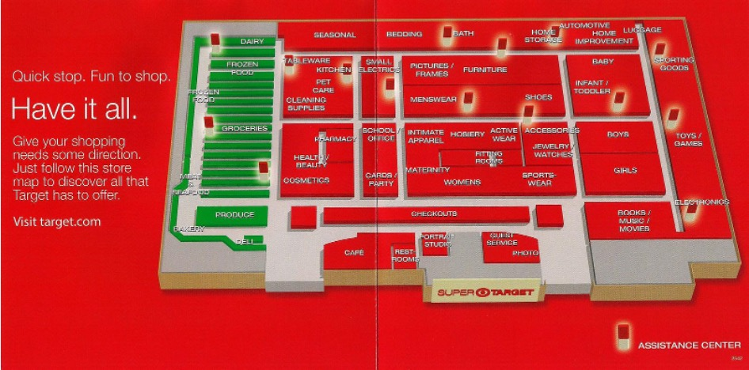
Diagram of Target vs. Super Target
Target
Super Target

Slide 9
Stakeholders
Sustainability and Governance Policies:
Climate consists of Greenhouse gas emissions, and climate-related risks and opportunities. Circularity consists of product and package design, and waste elimination and reduction.
Resource Use consists of environmental impacts of products, water use and management chemicals and Biodiversity.
Human Capital Management consists of compensation, benefits and well-being, workplace health and safety, talent, and development
Diversity, Equity & Inclusion consist of board and workplace diversity
Serving and Strengthening Communities consist of community impact and access to products and services
Ethical Business consists of government advocacy, privacy and cybersecurity, product quality and safety
Responsible Supply Chains consist of purchasing practices, human rights and animal welfare

Slide 10
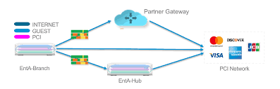
Topologies
WAN:
WAN provides more widespread connection between devices and can connect however many devices wirelessly
Wireless WAN would be efficient for use inside of Target because you can connect each device wirelessly
it doesn't need to have any cordlike connection. WAN is mostly used for larger enterprises such as Target
WAN provides a wireless network anywhere in the network providers coverage zones for access.
It provides connectivity for a range of situations that are not suitable for LAN

Slide 11
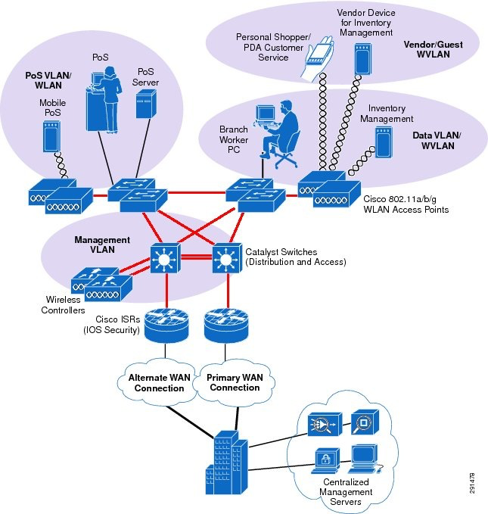
Topologies
LAN:
provides a connection within a collection of devices together in one setting/location
LAN networking requires Ethernet cables and Layer 2 switches along with devices that can connect and communicate using Ethernet
larger LAN’s often include Layer 3 switches or routers to streamline traffic

Slide 12
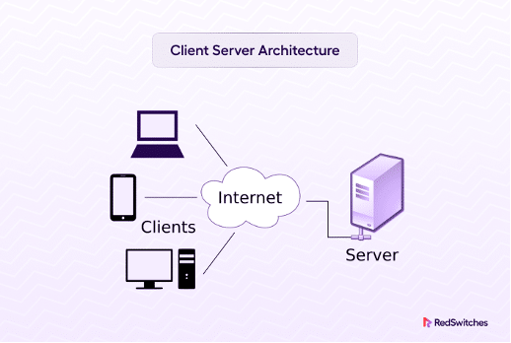
Topologies
Server Configuration:
Step 1: Set the Server Backup
Step 2: Set up remote access
Step 3: Set sharing options
Step 4: Set the server as domain
Step 5: Allow all computers to join the network
Step 6: Allow the server to authenticate user credentials
Step 7: Add a local admin account to each PC
Step 8: Organize and upload the data and applications
The server of Target would include 5 or more clients(desktop/laptops), a switch, and a firewall.

Slide 13
IP Addresses Ranges for Target
There are 277 domain names hosted across 7 IP Addresses
IP Address | Domain | Domains On This IP
161.225.130.163 | httptarget.com | 147
161.225.130.97 | shopsontarget.com | 123
161.225.195.239 | targetnationalbank.com | 3
161.225.203.239 | targetgifmaker.com | 3

Slide 14
URL and Website DNS IP Address
https://www.target.com/ is the official website for Target department stores. Clients can explore and buy a variety of products on Target's online shopping platform by using this URL
Target DNS IP Address is 161.225.130.163 rdr3.target.com The DNS IP address for the Target department store website is 151.101.2.187

Slide 15
References
Works Cited
guide, s. (2024, January 16). NFT Non Fungible Token. Retrieved March 3, 2024, from Lark: https://www.larksuite.com/en_us/topics/retail-glossary/nft-non-fungible-token
Hanna, K. T. (n.d.). What is a barcode reader (POS scanner, barcode scanner, price scanner)? Retrieved March 3, 2024, from TechTarget: https://www.techtarget.com/whatis/definition/barcode-reader-POS-scanner-bar-code-reader-price-scanner
How To Set Up A Server For A Business | Avast. (n.d.). Retrieved March 3, 2024, from Avast Blog: https://blog.avast.com/setup-server-business-avast
Li, T. (n.d.). What Is a POS System and How Does It Work? Retrieved March 3, 2024, from Investopedia: https://www.investopedia.com/terms/p/point-of-sale.asp
Number of Target stores in the United States. (n.d.). Retrieved March 3, 2024, from Scrape-It.Cloud: https://scrape-it.cloud/brand-reports/target
Pickup & Delivery. (n.d.). Retrieved March 3, 2024, from Target Corporation: https://corporate.target.com/about/products-services/pickup-delivery
Sustainability & Governance Priorities. (n.d.). Retrieved March 3, 2024, from Target Corporation: https://corporate.target.com/sustainability-governance/governance-and-reporting/priorities
Target History Timeline. (n.d.). Retrieved March 3, 2024, from Target Corporation: https://corporate.target.com/about/purpose-history/history-timeline?era=2
Target's Products & Services. (n.d.). Retrieved March 3, 2024, from Target Corporation: https://corporate.target.com/about/products-services
What is WAN? - Wide Area Network Explained. (n.d.). Retrieved March 3, 2024, from AWS: https://aws.amazon.com/what-is/wan/

